Slide 1

CER Data Overview
By Team Sand Cat
Sherri Haas, Vivian Kan, Robin Millican, and Peizhi Yang

Slide 2
CER Smart Metering Project Electricity Consumption Behavior Trial: Overview and Pilot Purpose
Goal: To effect measurable change in consumer behaviour in terms of reductions in peak demand and overall electricity use for a national rollout through four trials
Participants: 5028 residential customers, 728 small-to-medium enterprises (SMEs), 60 pre-payment customers, 11 multi-site users
Timeline: 18 months (July 2009 - December 2009), with first 6 months dedicated to collection of energy consumption benchmark data
Residential Results: Time of Use (ToU) tariffs and demand side management (DSM) stimuli reduced overall electricity usage by 2.5% and peak usage by 8.8%
SME Results: ToU tariffs and DSM stimuli reduced overall electricity usage by 0.3% and peak usage by 2.2%, but results were not statistically significant
Notes:
•Commission for Energy Regulation (CER) is Ireland’s electricity and natural gas regulator
•“The Smart Metering Electricity Customer Behaviour Trials (CBTs) took place during 2009 and 2010 with over 5,000 Irish homes and businesses participating.”
•“The purpose of the trials was to assess the impact on consumer’s electricity consumption in order to inform the cost-benefit analysis for a national rollout. ”
“customers …had an electricity smart meter installed in their homes/premises and agreed to take part in research to help establish how smart metering can help shape energy usage behaviours across a variety of demographics, lifestyles and home sizes.”
““to ascertain the potential for smart meter technology to effect measurable change in consumer behaviour, which will result in the reduction of peak demand and overall energy use, when operated with appropriate Demand Side Management initiatives(DSM).”
Also wanted to ascertain “tipping point” where price significantly impacted consumer decisions
SME is defined to be an enterprise with up to 249 employees with either an annual turnover not exceeding €50m or an annual balance sheet total not exceeding €43m28.

Slide 3
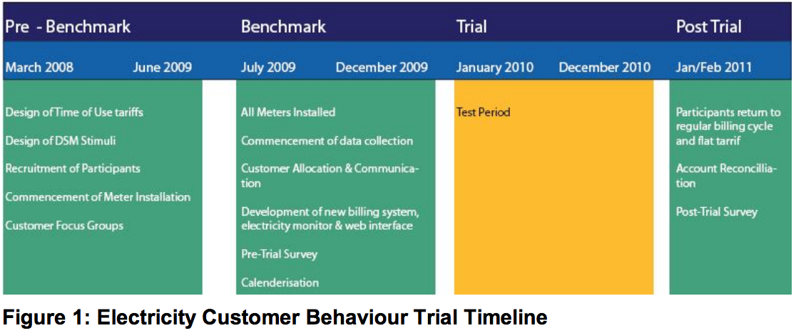
Residential and SME Timeline

Slide 4
Pilot Design (Residential)
Randomly assigned to control or treatment group
Treatment groups were assigned one of four TOU rates (Tariff A-D) and one of four combinations of information interventions
Weekend tariff
Cost neutral to participants
Fridge magnet and sticker informed different timebands and cost per band
In-Home Display (IHD) showed usage and cost; included a budget function
Customer focus groups provided insight and feedback on the draft tariffs and layout of energy statement and electricity monitor
Calendarization of bills; changes to billing cycle to some customers
Notes:
Third step: Smart meters installed and benchmarking usage phase(July-December 2009)
Fourth step: Dividing into control and treatment groups, testing with time of use and demand side management stimuli (Jan-Dec 2010)
Four ToU tariffs (A, B, C and D) are mixed with four DSM stimuli (bi-monthly bill and
energy statement; monthly bill and energy statement; bi-monthly bill, energy statement and
electricity monitor; and bi-monthly bill, energy statement and the Overall Load Reduction incentive) are used in
the CBT. Weekend tariff was also used in the Residential CBT. Energy state provides additional detail on usage and tips on energy reduction.
Control group: continued with typical flat rate and no changes to the billing frequency
Fifth step: post trial survey evaluating change in attitudes, equipment use
NOTE: TOU tariff is neutral in comparison with standard Electric Ireland tariff. Avg participant who did not alter electricity usage was not penalized financially through balancing credits.
Calendarization to help with comparison of usage

Slide 5

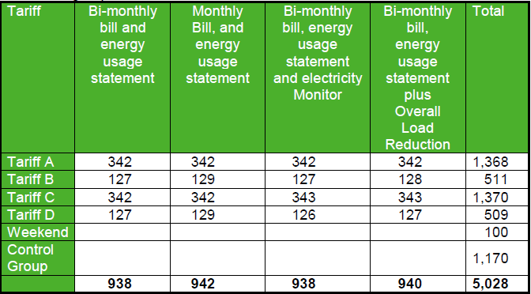
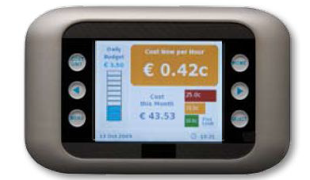
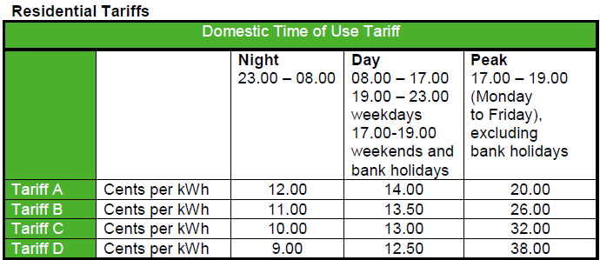
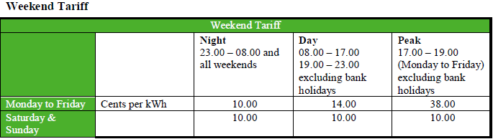

Slide 6
Pilot Design (SME)
SME CBT trial had a similar program design. Treatment groups were assigned one of two TOU rates and one of four combinations of information interventions.
Cost neutral to participants
Customer focus groups provided insight and feedback on the draft tariffs and layout of energy statement and electricity monitor
In-Home Display (IHD) showed usage and cost; included a budget function
Calendarization of bills; changes to billing cycle to some customers
Notes:
SME is commercial organization with a single site. 2 participating suppliers (Electric Ireland and Bord Gais Energy)
Four combinations of DSM stimuli:
Bi-monthly bill, energy use statement, electricity monitor
Bi-monthly bill, energy use statement, web access
Monthly bill, energy use statement
Bi-monthly bill, energy use statement
NOTE: Bord Gais Energy customers also got bi-monthly bill and energy use statement; they priced participants on an individual basis
Web access allowed: usage and costs across different time, compare with historical usage and costs

Slide 7
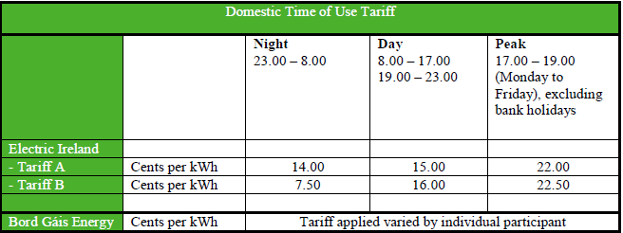
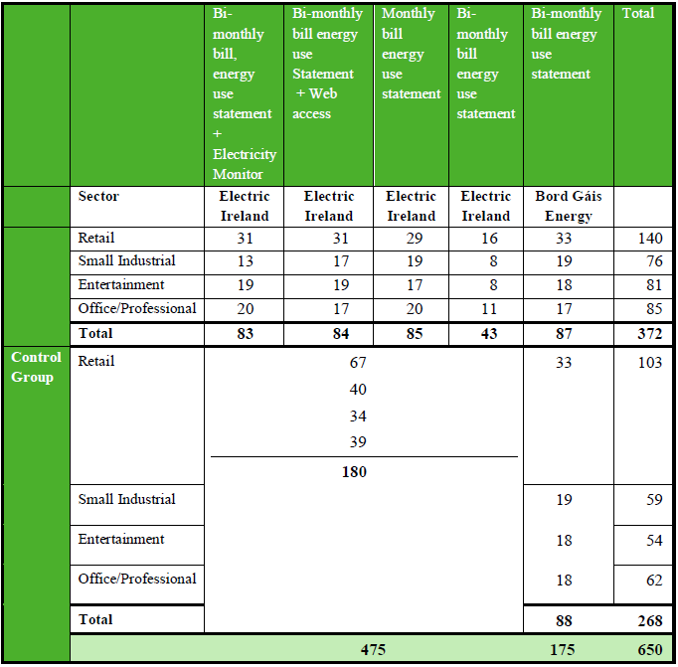

Slide 8
Residential Recruitment and Sample Construction
Voluntary participation, with small financial incentive of 50 euros paid in two installments
Five “waves” of invitations dispatched, with adjustments to ensure participants were representative of national demographics and usage rates
Pre-trial telephone-based survey and focus groups conducted to compare non-respondents and trial participants
Post-trial survey used to compare participant outcomes
Surveys inquired about “household demographics, socio-economic indicators, presence and use of different electrical appliances, investment in energy efficiency enhancement, attitudinal information, as well as expectation of the impact and outcomes from the CBT itself.”
Notes:
First step: Recruitment -- voluntary with small financial incentive
Second step: Pre-trial survey to determine representation, baseline: “The non-response survey was conducted using Computer Assisted Telephone Interviewing (CATI) once recruitment had been completed in July 2009.” “To ensure that the set of consumers wishing to participate in the Trial was similar to the whole population, a non-response survey was completed and the profile of responses among non-respondents and trial participants compared.” (p. 41)
-Pre- and post-trial surveys, all participants required to participate in a computer assisted telephone interview based survey
-Household demographics, socio-economic indicators, the home, presence and use of different electrical appliances, investment in energy efficiency enhancement, attitudinal information, as well as expectation of the impact and outcomes from the CBT itself

Slide 9
SME Recruitment and Sample Construction
Voluntary “opt-in” approach
Selected SMEs with a single site and “reasonable payment history” over previous year
Combination of letter invitation and phone call
Used consumer base information from two participating electricity suppliers to determine if sample was representative relative to other SME customers in four sectors: entertainment, manufacturing, offices and services, and retail
.

Slide 10
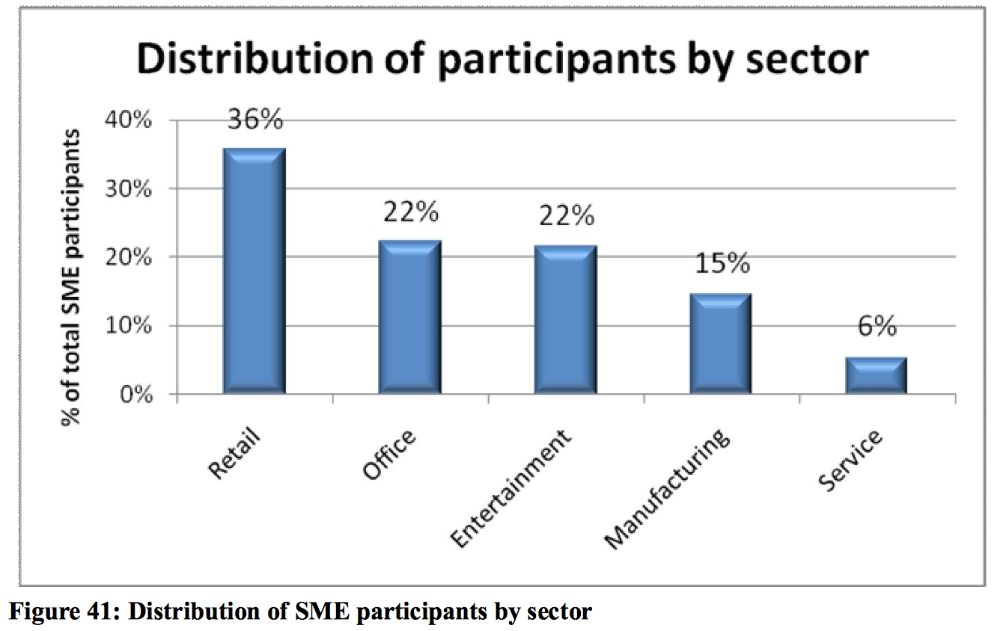
Notes:
Unlike the residential trial, the SME Trial did not attempt to be representative of the entire SME sector. Instead it focused on providing insight into reduction in these significant sub-sectors
Compared to the residential trial, the participants in the SME Trial were necessarily more diverse across opening hours and days, operations during peak hours, and type of equipment used

Slide 11
SME Recruitment and Sample Construction, cont.
Pre-trial phone survey for both participants and non-respondents
Post-trial phone survey to compare participant outcomes
Surveys inquired about size of the business, the sector, the premises (including hours of operation), equipment used, and attitudinal information about expected impact and outcomes from the trial
.

Slide 12
Implementation and Analysis Challenges
Some Overall Load Reduction participants could not recall the existence of a target. The OLR was an additional financial incentive for reducing use 10% below historical consumption levels.
Better implementation of the program in this regard may have lead to greater decreases in usage.
Self Selection into the Program - while significant efforts were made to achieve a representative sample of the population in the program, it is possible that the participants differed in some way from the general population, leaving questions of external validity.
“Even with the adjustments made during the recruitment process, there is under-representation among lower usage consumers and over-representation among medium to high consumption consumers”, but the level of over and under representation is relatively low.
Notes:
OLR (overall load reduction) is a financial incentive for reducing use 10% below actual historical consumption
Collecting info from everyone via survey –answers may differ from real behavior
Selection into program (“Recruitment to the Customer Behaviour Trial was on a voluntary basis (with a small financial incentive associated with the completion of the survey” “To allow for correction of representivity issues during recruitment a multi-wave approach was chosen with invitations dispatched in five groups.” “Representivity (based on usage and location) of the acceptances were verified after each wave and adjustments to the subsequent waves made to maximize the overall representivity of the set of acceptances. “).
Attrition (p. 35)
“It is clear than even with the adjustments made during the recruitment process, there is under-representation among lower usage consumers and over-representation among medium to high consumption consumers… However, the level of over- and under-representation is relatively low and has a minimal impact on estimates of volumetric changes as the under-represented low usage consumers contribute proportionately less to the total quantity of electricity consumed.”
No location data available

Slide 13
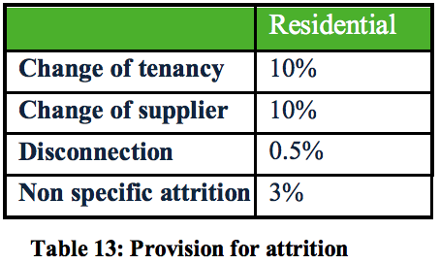
Implementation and Analysis Challenges
Residential Attrition
Within their expected range
Noted that those who switched supplier
did not do so because of the trial
SME Attrition
Similar overall rate of attrition (23%)
Primary reason was change of supplier
High degree of variability in usage pattern among businesses.
Would require a much larger sample size than Residential CBT to achieve same power.
Maintained rigorous approach to experimental design but recognized that the findings were likely statistically insignificant.
Location data is not available, reduces the type of analyses that can be done with the data (for example, connecting to weather patterns).

Slide 14
Additional Resources
Journal Articles using the CER Smart Meter Data
Carroll, J., Lyons, S., & Denny, E. (2014). Reducing household electricity demand through smart metering: The role of improved information about energy saving. Energy Economics, 45, 234-243. doi:http://dx.doi.org/10.1016/j.eneco.2014.07.007
Commission for Energy Regulation. (2011). Electricity Smart Metering Customer Behaviour Trials Findings Report. Retrieved from http://www.cer.ie/docs/000340/cer11080%28a%29%28i%29.pdf
Hyland, M., Leahy, E., & Tol, R. S. J. (2013). The potential for segmentation of the retail market for electricity in ireland. Energy Policy, 61, 349. Retrieved from http://search.proquest.com/docview/1448218009?accountid=10598
PwC. (2014). National Smart Metering Programme (Electricity & Gas) Cost-Benefit Analysis. Retrieved from http://www.cer.ie/docs/000699/CER14046E%20PwC%20Cost%20Benefit%20Analysis%20report.pdf
Notes:
Follow up PwC cost benefit analysis done

